Slide 1
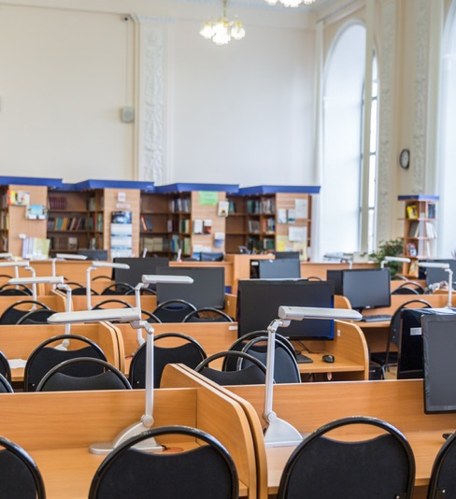
MAR - APR 2025
VOL 20 | ISN 8
WEEKLY GAZETTE
THE OFFICIAL NEWSLETTER OF MURRAYFIELD COLLEGE
ARTICLE TITLE HERE
ARTICLE TITLE HERE
A newsletter is a regularly distributed publication that is generally about one main topic of interest to its subscribers. Newsletters differ from newspapers as it focuses on a smaller audience and niche topics.
Newspapers are used by clubs, churches, organizations, schools, and businesses to provide information to members, customers, students, and employees.
It's a great way to provide detailed but easy to read articles.
Newsletters are one of the most efficient and reliable ways to keep parents updated on what's happening with their kids and the school.
Whether in email or printed format, newsletters are a better alternative for weekly parent and teacher meetings. It's also a great way to connect with the preschool's community.
It's a great method to keep the communication lines open between the teachers and the school administration.

Slide 2
MAR - APR 2025
VOL 20 | ISN 8
TITLE HERE
By: Author
A newsletter is a regularly distributed publication that is generally about one main topic of interest to its subscribers. Newsletters differ from newspapers as it focuses on a smaller audience and niche topics.
Newspapers are used by clubs, churches, organizations, schools, and businesses to provide information to members, customers, students, and employees.
Newsletters are one of the most efficient and reliable ways to keep parents updated on what's happening with their kids and the school.
Whether in email or printed format, newsletters are a better alternative for weekly parent and teacher meetings. It's also a great way to connect with the preschool's community.
TITLE HERE
By: Author
Newsletters are a great way to update everyone at school about the latest happenings. It's a material that can easily tap a wide-audience and anyone can pick up. From students to faculty members, personnel and administration. Anyone can spare time to read it.
Use it as a resource to share relevant information, updates, and entertainment. Articles with strong messages on the front page can reel in readers' attention. Keep them eager to continue reading with fascinating previews of other articles they can find in the issue. Complement stories with eye-catching photos. A compelling newsletter is a fantastic combination of awesome text and brilliant photos that gets the story across.

Slide 3
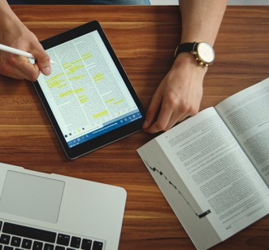
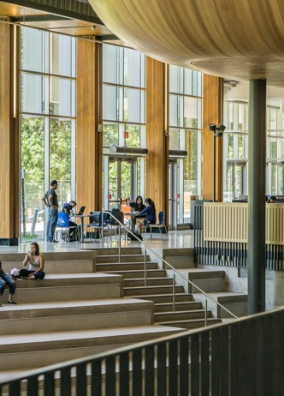
MAR - APR 2025
VOL 20 | ISN 8
WRITE ARTICLE TITLE HERE
The inside pages plays an important part in sharing news, as it is where readers can find the heart of the articles. Appeal to their interest with a non-intimidating layout that spreads the content evenly for an easy-going experience. The layout should also invite them to continue where they left off. Don't forget to double check sources! Credibility is crucial.
WRITE ARTICLE TITLE HERE
As readers progress through the newsletter, it's great to reward them with a little extra something. Add different sections for a variety of lighter information, such as music, movies, or technology.
Include bite-sized notes on the latest releases, or do reviews. Giving the audience new things to consider that aren't easily found on the Internet helps build trust along the way.
WRITE ARTICLE TITLE HERE
For the last page, opt to place an entertainment section for fun. Get creative and add crossword puzzles, mazes, and other games to get readers to stay on a little longer.
Ask help from artistic individuals who can share their talent in illustrative storytelling. A funny comic strip or two brings an even friendlier tone to the newsletter.

Slide 4
MAR - APR 2025
VOL 20 | ISN 8
TITLE HERE
By: Author
Use pull quotes to highlight key points or serve as a graphic element.
Before creating your newsletter, plan on what you want to include. Gather the information and once you have that down, you can start playing with the layout. Go for a pared-back design that won’t look too crowded or busy, but complement that with punchy colors that can attract attention. Have enough amount of white space, but don't be afraid to include some fun graphics.
Make your newsletter an easy and pleasurable read by choosing a simple yet engaging layout. Feel free to feature high-quality photos of the kids enjoying a fun classroom activity or an exciting school event. Parents appreciate seeing their children on paper! You can also add some cute graphics and use your school colors to finish the look.
Parents can get most information about their children's schedule and activities from your newsletter. Keep it short and sweet so they won't get overwhelmed with information overload. Put the most important details—such as school events calendar—on the front page when it won't be missed.
Devote a space for some students' milestones and achievements, as well as highlights of what they learned in the recent month. Another great addition to the newsletter would be the school's weekly menu.
Encouraging parents to contribute to the newsletter is also a good idea. Be creative in making the newsletter an open and informative space for both kids and adults.
- Who said it?

