Slide 1
SEPT. 2024
VOL. 1
THE WEEKLY POST
OUR CLUB WEEKLY NEWSLETTER
ARTICLE TITLE HERE
WHAT'S INSIDE
- BY AUTHOR
ARTICLE TITLE
ARTICLE TITLE
ARTICLE TITLE
Encourage your students to exercise their creativity by starting a newsletter. While it seems like a daunting project, a student-made newsletter will give your kids firsthand experience in writing, research, planning, management, and design.
Start by helping them come up with a goal for their newsletter. Who will read it? What will it be about? Ask for suggestions on what the newsletter should be called, then have them vote on it. Pick their brains for ideas on what they can write about. Consider school events, community activities, or even the things that happen in their classroom.
Image caption here

Slide 2
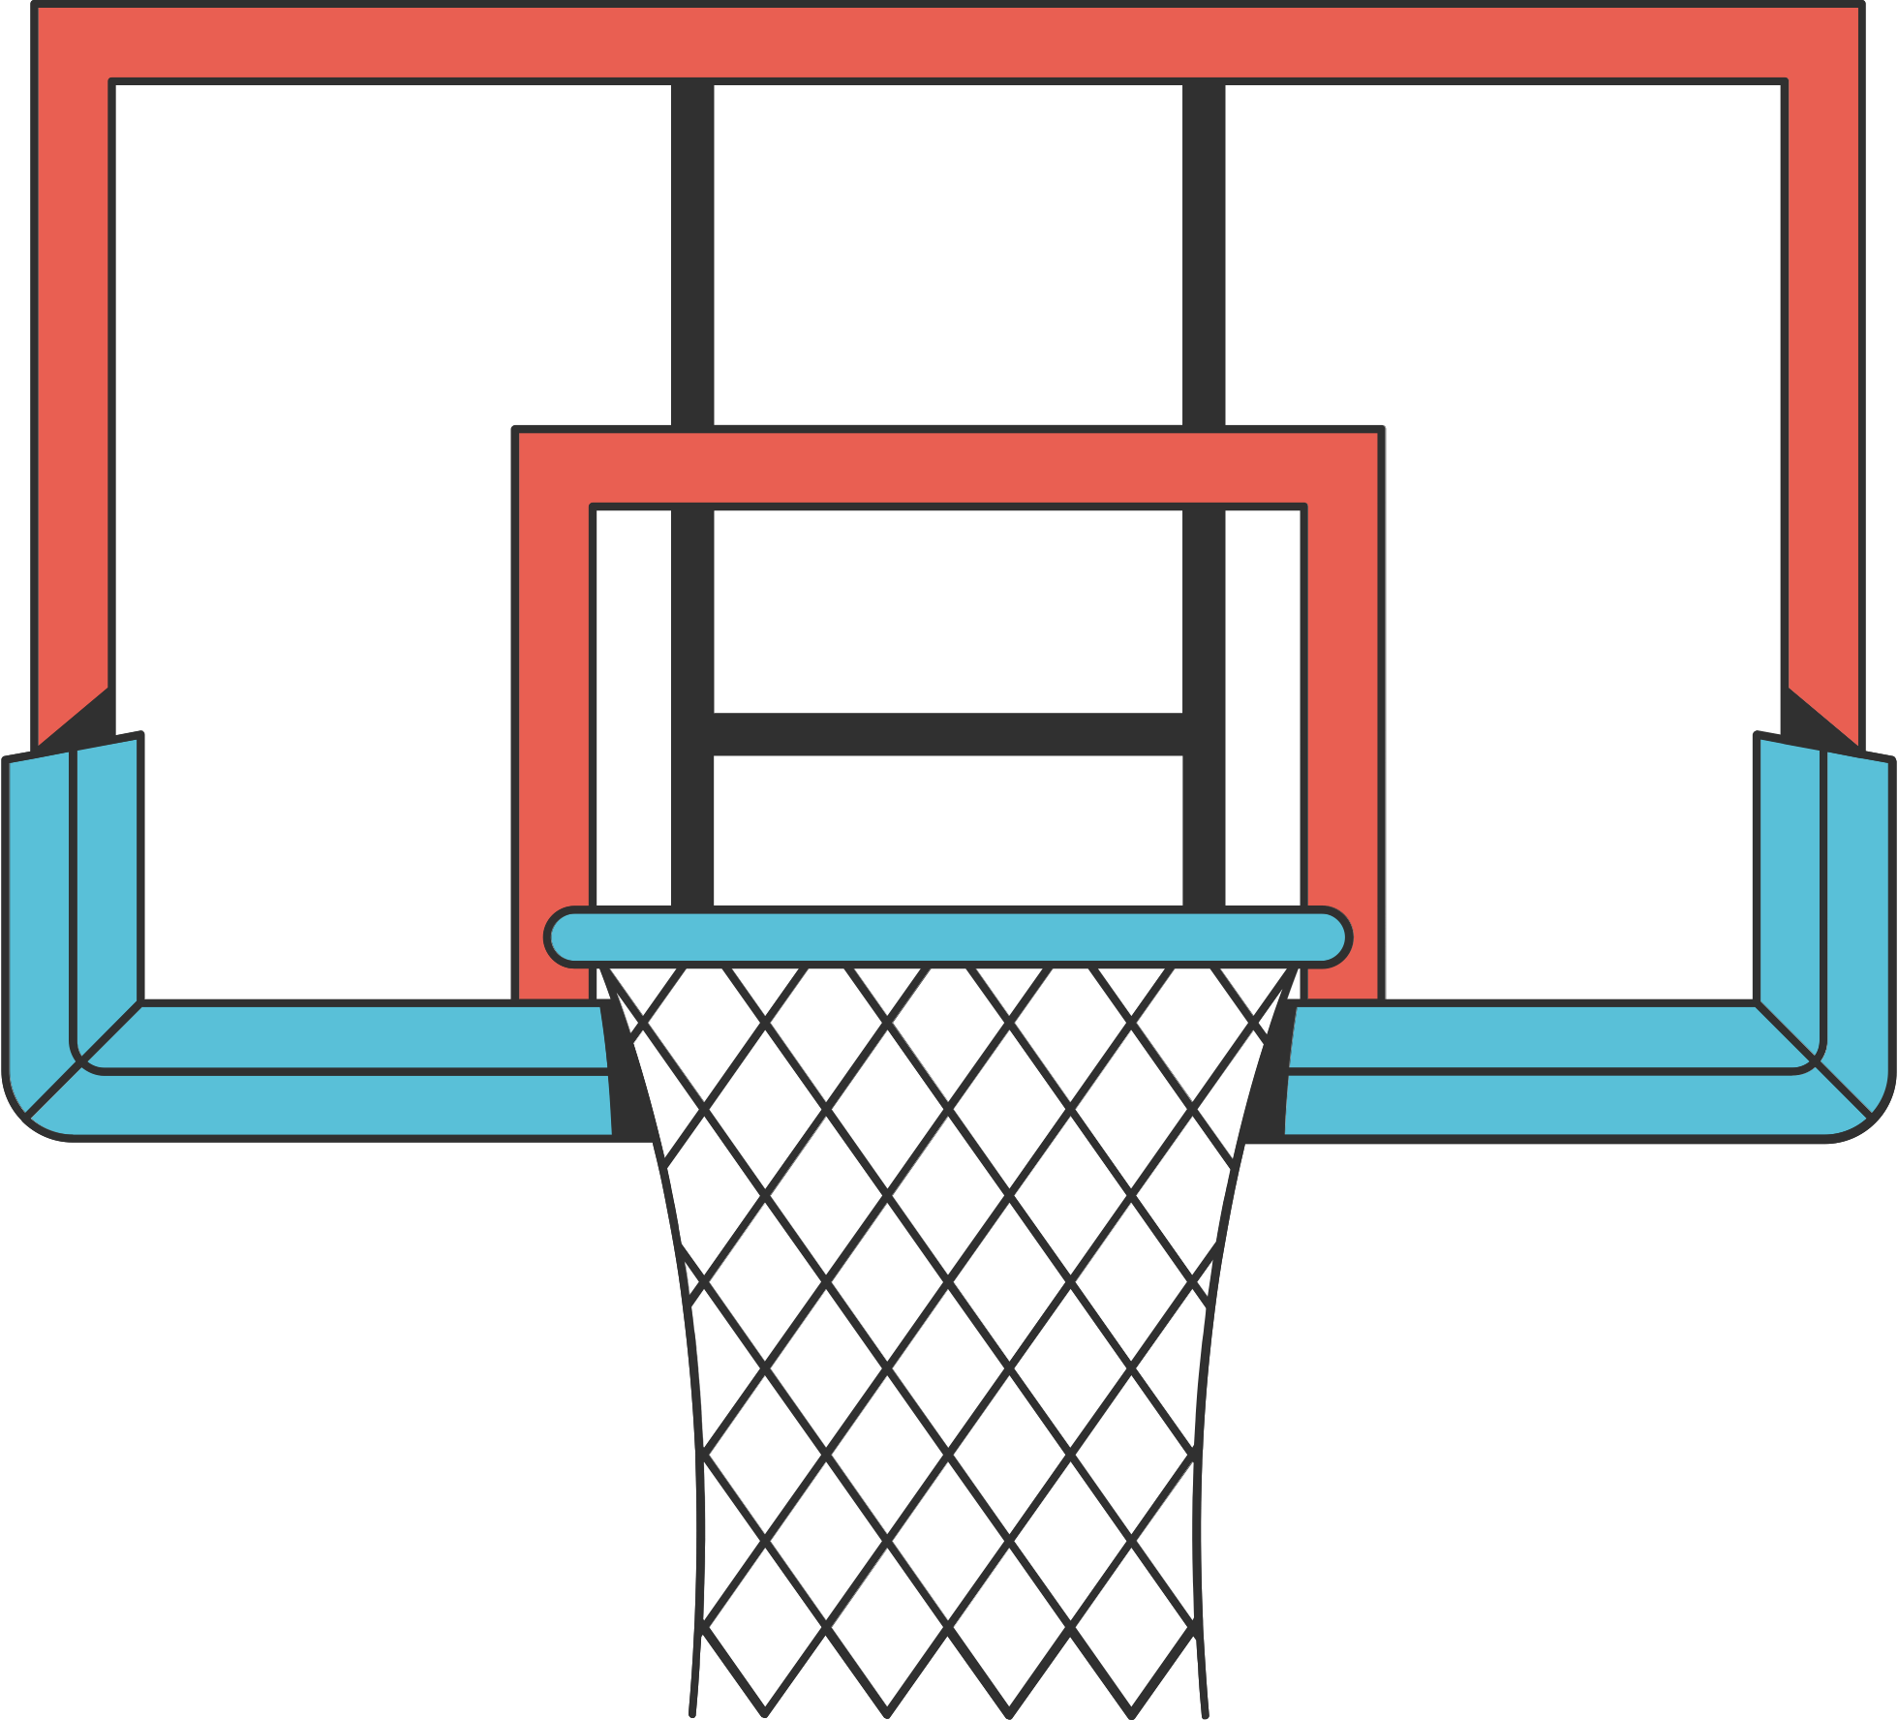
SEPT. 2024
VOL. 1
PLACE THE ARTICLE TITLE HERE
- BY AUTHOR
Aside from news articles, they can also feature their own literary efforts. Suggest that they write poems, songs, short stories, and one-act plays. Tell them they can write funny essays and silly jokes, too!
Design is another area where your students can learn. Give them the freedom to design without making things too complicated. It teaches teamwork and gives them a better appreciation of what each member brings to the table.
Image caption here
UPCOMING DATES
EVENT - DATE
EVENT - DATE
EVENT - DATE
ADD LINK TO DOWNLOADABLE CONTENT

Slide 3
SEPT. 2024
VOL. 1
THE ARTICLE TITLE GOES HERE
- BY AUTHOR
Make your newsletter more creative by encouraging your students to submit their illustrations and photos. Graphics don’t just break monotony; it gives your students a venue for their artistic efforts.
Encourage them to draw, paint, take photos, or make collages. After they submit their work, ask them to write interesting captions for their submissions, too.
Image caption here
Don’t stop at getting contributions from your students. You can get them involved in the actual production of the newsletter, too. Allow them to edit each other’s work. Make the students who excel in grammar go through the work of their peers.
Emphasize the importance of fact checking, then teach them how to do it themselves. Let them take turns on playing editorial board for each issue, so everyone can learn leadership and responsibility.

Slide 4
SEPT. 2024
VOL. 1
PLACE THE ARTICLE TITLE HERE
Start by asking the students to brainstorm on what to write or what to include in the upcoming issue. Let their imagination run free as they throw out ideas. Write their ideas in a shared brainstorm document. Group common themes to make ideas clearer.
Narrow down the topics by asking the kids to vote. When you have your top ideas, it's time to ask them what they want to work on. Students can be writers, editors, photographers, or illustrators.
- BY AUTHOR
Involving students in the creation of newsletters can be a great teaching opportunity. Not only does it give them space to exercise their research and writing skills, it can also be an avenue to hone their leadership and management skills.
CLUB NAME HERE
WWW.REALLYGREATSITE.COM

