Slide 1
Leadership and Team Building
Leadership in sports moulding cohesive teams, turning individual strengths into collective triumphs

Slide 2
Why is leadership important?
Strong leadership is at the core to building community, creating a sense of fun and belonging, resulting in high performing teams .
Building the talent pipeline, bringing in the next wave of officials, drivers and club members to ensure the future of our sport.
To deliver on our Customer first mentality
Notes:
We have moved on from the uncertainty of a COVID world to now look with fresh eyes as to the changing needs of club members and volunteer officials and opportunities to grow the officials base and support officials to have that fun and positive experience within Karting. How that officialing community may look in the future and everyone in the room can play an enormous part through their leadership.
Understanding needs - Cost of living, want recognition, add value, visibility, building the teams at all levels, variables. Want to learn

Slide 3
The reality of leadership at karting events
Challenges in Leading Teams to run karting events:
Competing priorities, lack of time
Differing personalities
Lack of skills or competence
People not showing up, late or have to go home early
Mental health
Impatience
Changing environments… Digital era
Social Media
Fear of responsibility
Risk and compliance
Notes:
So our opportunity here today is to think about how we can work together and support each other to navigate some of these challenges.
Differing backgrounds, states, event types, share our knowledge so we are better equipped to deal with these challenges.
And enjoy it. Most of these challenges are not unique to karting.

Slide 4
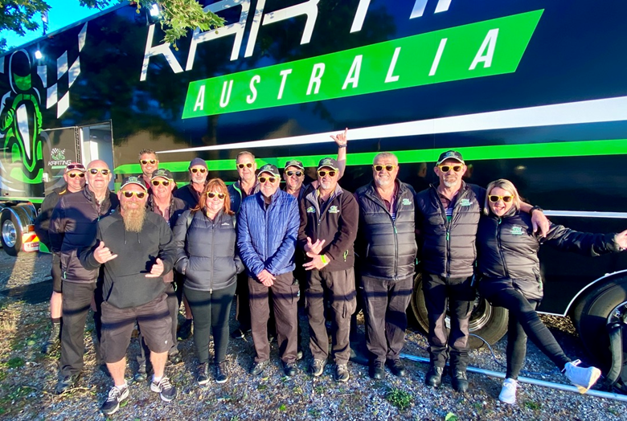
The future of leadership at karting events
Building effective teams and creating a strong sense of community
Understanding the needs of club members and volunteer officials.
Developing leadership skills and exploring possible leadership strategies.
Identifying areas of potential growth in the numbers of club members and volunteer officials.
Goal: develop high performing teams of club members and volunteer officials
Notes:
So our opportunity here today is to think about how we can work together and support each other to navigate some of these challenges.
Differing backgrounds, states, event types, share our knowledge so we are better equipped to deal with these challenges.
And enjoy it. Most of these challenges are not unique to karting.

Slide 5
Learning Outcomes
After todays session, participants should be able to:
Identify your leadership style and strengths.
Develop leadership skills and explore possible leadership strategies
Understand the needs of club members and volunteer officials in the current landscape.
Identify areas of potential growth within club members and volunteer Karting officials.

Slide 6
Leadership styles
Autocratic “Do as I say”
Authoritative “Visionary – Follow Me”
Pace-Setting “Do as I do!”
Democratic “What do you think?”
Coaching Style “Consider this”
Affiliative “People come first”
Laissez-Faire Style “Hands off”
Servant leadership
Authentic leadership
What style of leadership do you think you are?
What style do you best respond to?
Notes:
More info in a worksheet or similar – examples of situations that call for certain leadership styles
Part of worksheet – which styles do you default to? What makes you change styles.

Slide 7
Leadership Articles of interest
Self Development: Lead Yourself Before You Can Lead Others | by O'Reilly Media | oreillymedia | Medium
How to Play to Your Strengths (hbr.org)
Frontiers | Athlete Leadership Development Within Teams: Current Understanding and Future Directions (frontiersin.org)
Succession planing | Australian Sports Commission (ausport.gov.au)
Why Diverse and Inclusive Teams Are the Engines of Innovation | Great Place To Work®

Slide 8
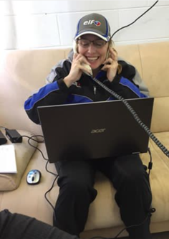
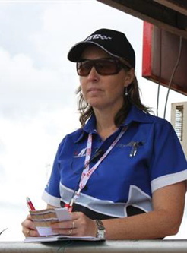
Sense of self.. Can’t lead others without self awareness (activity)
Post workshop activity and reading: “Play to your strengths” article
At a karting event in your regular role… what do you think your team
would say are your greatest strengths?
What do you think are your top strengths?
▪ Worksheet – key strengths
And how does this impact others
1 action you will take as an individual

Slide 9
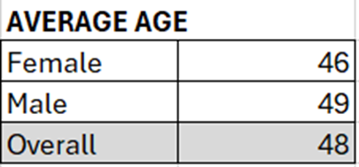
The role of a leader in team building
What do our volunteer official teams currently look like over 360 events in 2023? 366 Active Officials, 42 of which attended more than 11 events.
Future teams – the impact on a leader in team building
Notes:
Thoughts on current landscape. Where can the growth and what do future teams potentially look like? Can collecting data from club surveys help to inform your decision making?

Slide 10
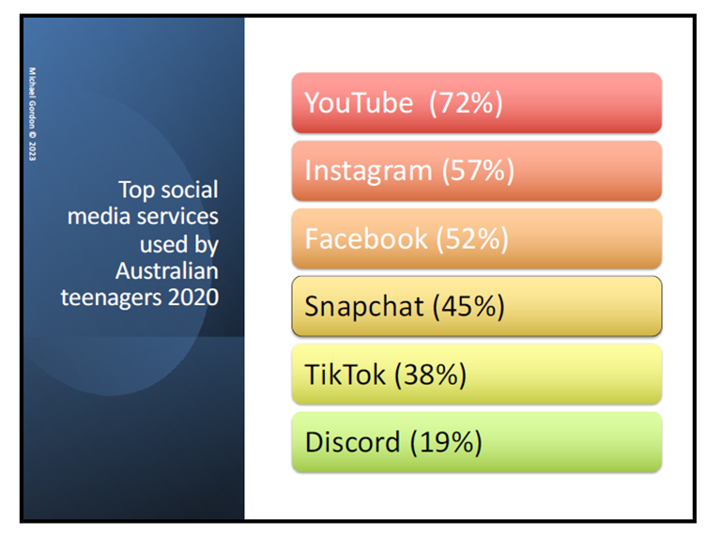
Future teams – the role of a leader in teambuilding.
Teenage Demographic – leading into18-30 age bracket.
Using Social Media in a Positive Way
- Set clear boundaries for use of phone and social media.
- Capturing and sharing photos.
-Opportunities to connect with a wider audience.
Mental Health Awareness and Support
- Greater awareness and resources available for mental health.
In a leadership role how does this impact on team building?
Source: Associate Professor Dr Michael Gordon,
Monash Health Child Psychiatrist 2023

Slide 11
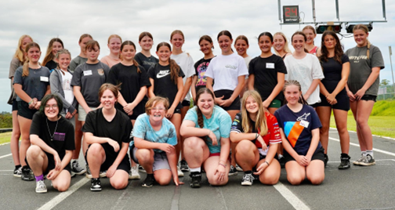
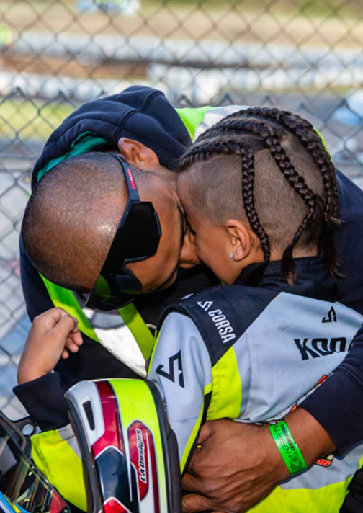
Diversity
Diversity can be represented in Gender, race, age, experience (on and off track), religious background, personal and professional background, political preferences
The opportunity that diversity brings:
▪ Increase the overall skill set, make better decisions
▪ Improve attitudes, drive continuous improvement and innovation
▪ Can greater diversity provide some growth in the next wave of club members and volunteer officials.

Slide 12
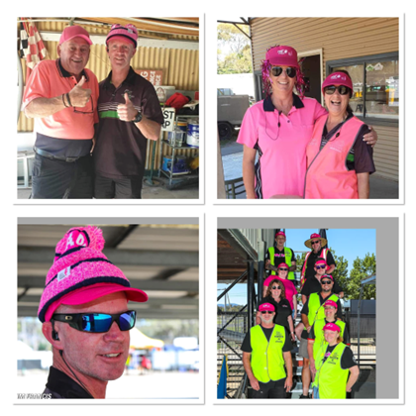
Diversity – How to foster it
All team members have a responsibility to embrace and support diversity. For each person this means:
▪participate in creating an environment that is inclusive of all team members, regardless of gender and culture.
▪ challenge gender and cultural stereotypes, seeking to eliminate real or perceived barriers that exist in relation to gender and culture.
▪ assist where possible in supporting, maintaining, promoting and celebrating diversity and inclusiveness of gender and culture.
How to foster it?
▪ Having regular and timely conversations,
▪ Show empathy and vulnerability
▪ Role model in words and actions – how do you present yourself?
▪ Do you call out behaviour which may make others feel uncomfortable?

Slide 13
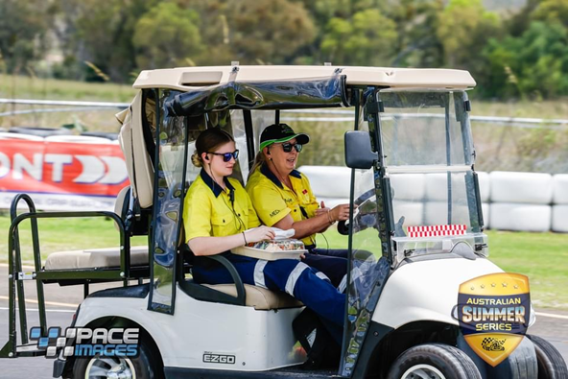
Conversation Starters
What made you want to get involved?
What interested you most about being an official / driver / club member?
What was the highlight of your day?
Was there anything that surprised you today?
What did you enjoy about working with Jo today?
Was there anything you would have done differently?
How did that make you feel?
Is there something you’d like to learn next time?
How do you think that went?
If there were three things you took away from that experience, what are they?

Slide 14
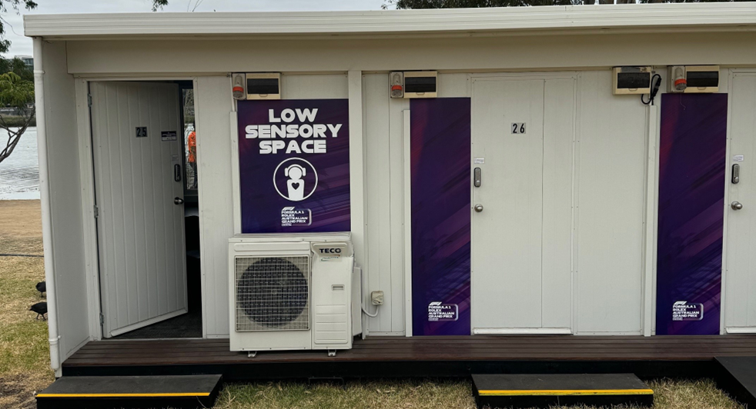
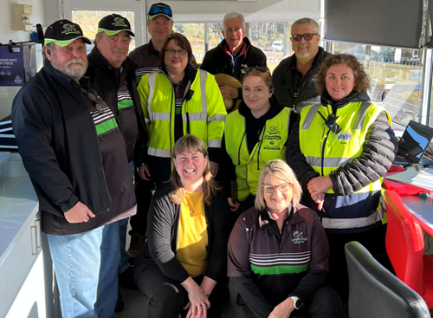
The role of a leader in team building
Communication
Understanding the needs of team
Valuing each team member
Be open to new ideas
Embracing the differences each team member brings
Sharing knowledge and experience
Who is your number 2? Who is your number 3?
Creating learning opportunities, safe spaces to make mistakes and learn
Put the headset on and listen in, have a conversation later on about it.
Listen and reflect – how do you know if you are doing a good job?
Build psychological safety, allow vulnerability
The debrief circle

Slide 15
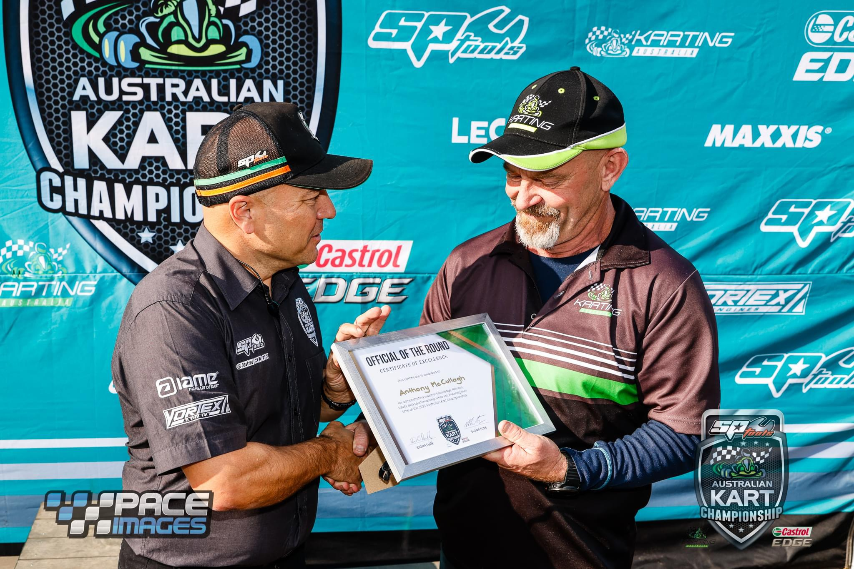
Team Building Strategies in motorsport
Set and agree on clear goals and expectations for the team
Openness – timely feedback, frequently
Start of the day, close the day huddle – informal open and close with individuals
Focus on celebrating the highs, and what can we learn
Capturing and sharing photos – doesn’t need to be official photographers
Small budget to buy something – coffee, raffles, prizes, hot chips on cold day, activities to have a bit of fun,
BBQ’s, social events
Training events
Setting reminders in your calendars – make time prioritise time to build relationships
Buddy, mentors
Visibility in club communications
Celebrating success and milestones
Using opportunities to share experiences – doesn’t have to be for long periods
Rotate the roles
Honours and Award program

Slide 16
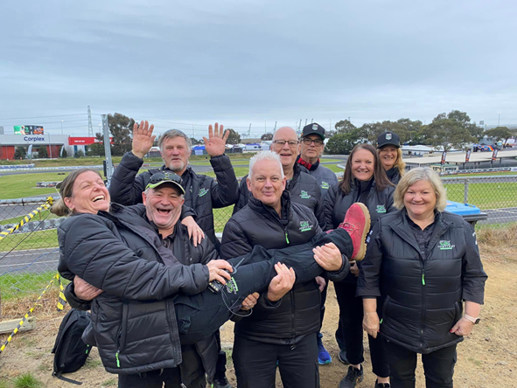
Discussion Question:
What are 2-3 strategies we can use to build high performing teams ?
Which will build our karting community
Ensure sense of belonging and have fun
Develop the next generation and future teams of club members, drivers and officials

